Slide 1
Week6 Activities
Search Win_2022 for venerability
Tevin Herath

Slide 2
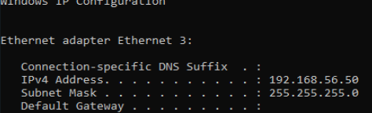
Search using Nmap
This activity includes searching for vulnerability using NMAP software
Purpose: Find Vulnerability – Open Ports
Steps:
Find my IP Address:
Command: ipconfig

Slide 3
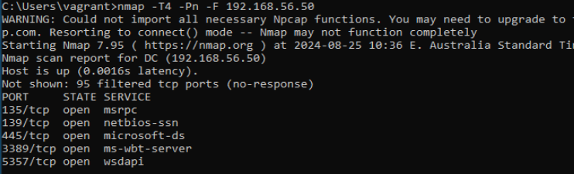
Search using Nmap (Cont.)
Install Namp and execute the following command:
nmap -T4 -Pn -F 192.168.56.50

Slide 4
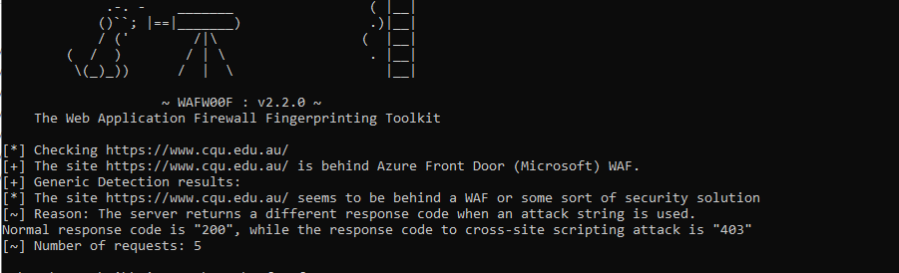
Scan using wafw00f
Purpose: Find Firewalls using WAFW00F
Activity: Scan CQU university website:
Install wafw00f:
Pip install wafw00f
Scan using wafw00f:
Wafw00f –a https://www.cqu.edu.au/

Slide 5
Nessus Scan
Setup Nessus Scan
Start Scanning

Slide 6
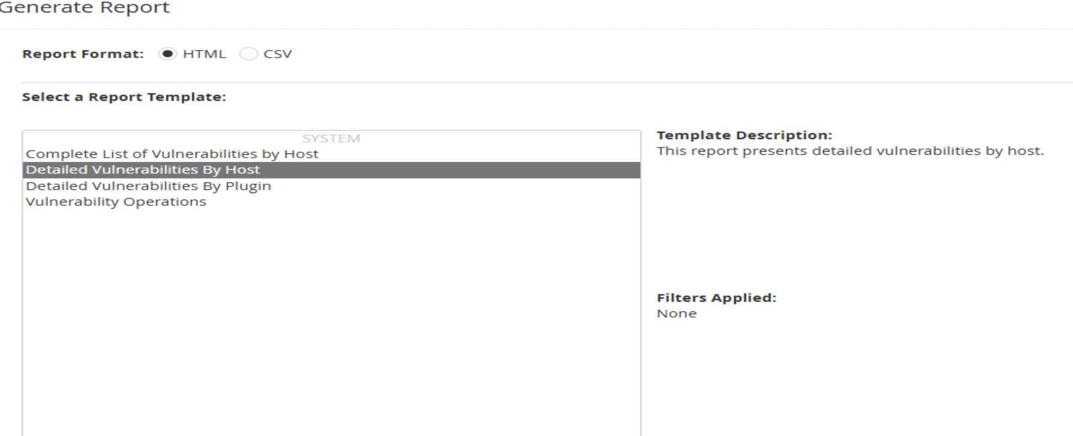
Nessus Scan – Report generation
Note: The report is included in Week7 Activities

Slide 7
Week 6 – Weekly Handout
1. Explore Cyber Laws:
Through this activity, I gained a deeper understanding of the various cyber laws that govern the protection of data and information in digital environments. I learned about the critical role these laws play in regulating online behavior, securing networks, and ensuring that organizations comply with legal standards when handling sensitive data.
2. Assess the Risk of a Small Information System for One Important Data Set:
This activity allowed me to practice assessing the risk associated with managing a small information system that handles a critical data set. I identified potential vulnerabilities using scanning tools such as NMAP and Nessus

Slide 8
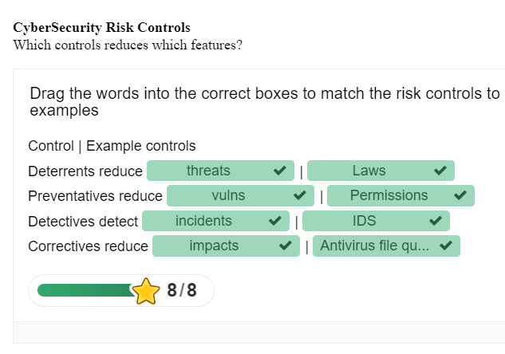
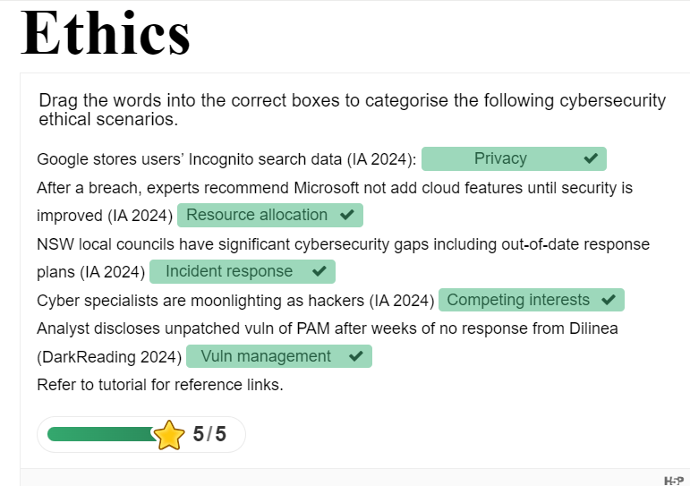
Week 6 – Activity worksheet

Slide 9
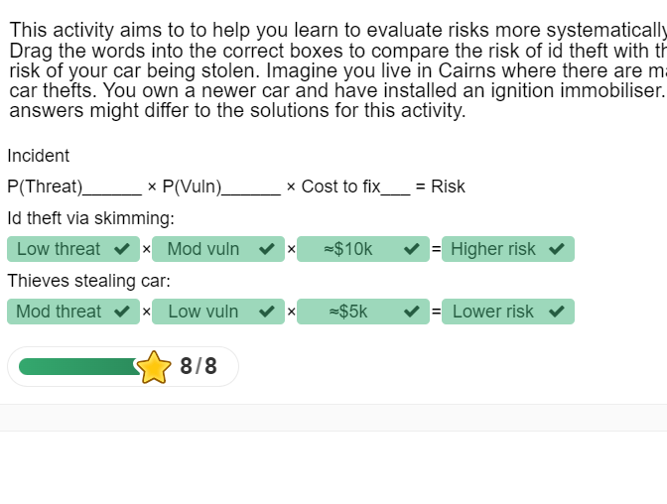
Week 6 – Activity worksheet (Cont.)

